Slide 1
Project: Visualizing production of album’s
Professor: Marco Winckler
Author’s: Mohammed Danish Mustafa
Madzella Yannick
Md Abdul Mazed Siddiki
December 12,2022

Slide 2
Introduction
Data visualization techniques are used to represent the large set of data in the simple format for the better understating and summarize the total data into a simple picture or in the simple format.
There are so many data visualization techniques which are available to represent different types of data in the different formats and in different representations with so many colors and graphical mode.
In this project we choose World Map, Pie Chart, & Gantt to represent data because World Map, Pie Chart & Gantt have the capability to show all data by categorizing and segregating all data based on the values. So, we can be able to understand the total strength based on the area the category covered.

Slide 3
WASABI Data Set
The WASABI dataset is from the music data base has all song lyrics and from audio analysis. The dataset contains 1.73M songs with lyrics at different levels and huge number of artists and their bands, origins, type of the band, group information etc.
There are so many features to work and explore in this data set. Wasabi data set we can avail in the three different segmented formats namely as follows.
Songs data set – 2.1 m samples.
Album data set – 208 k samples.
Artist data set. – 77 k samples.

Slide 4
Objective
The goal of this project to visualize the:
Acceptance of Rock Album over a period of time in entire World (“World Map’’)(1965-2015).
Percentage of people liking different Genre of Album (“Pie Chart’’).
Number of Different Genre of Album Composed in a single year by different countries(‘’Gantt’’).

Slide 5
Attributes From WASABI
* Country
* Genre
* Id Artist
* Language
* Name
* Title
* Deezer Fans

Slide 6
Project Informal Description
*Loading Data Set.
*Missing Date’s.
*Joining two data sets.
* Clustering.
* Generation Of Final Data Set.

Slide 7
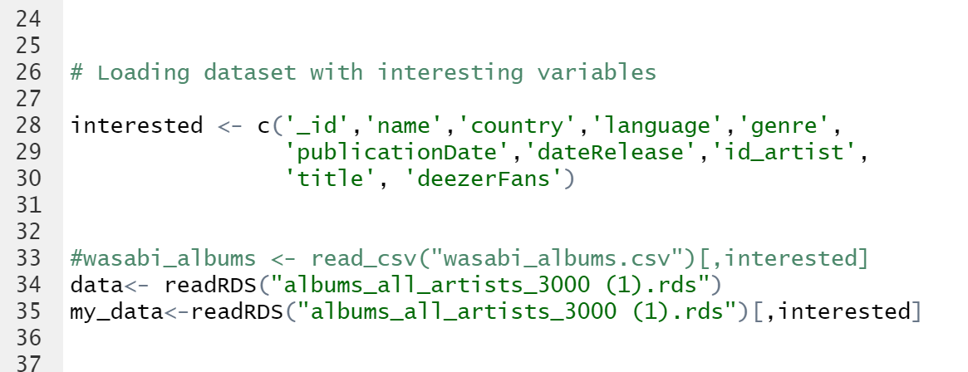
Loading and column selection

Slide 8
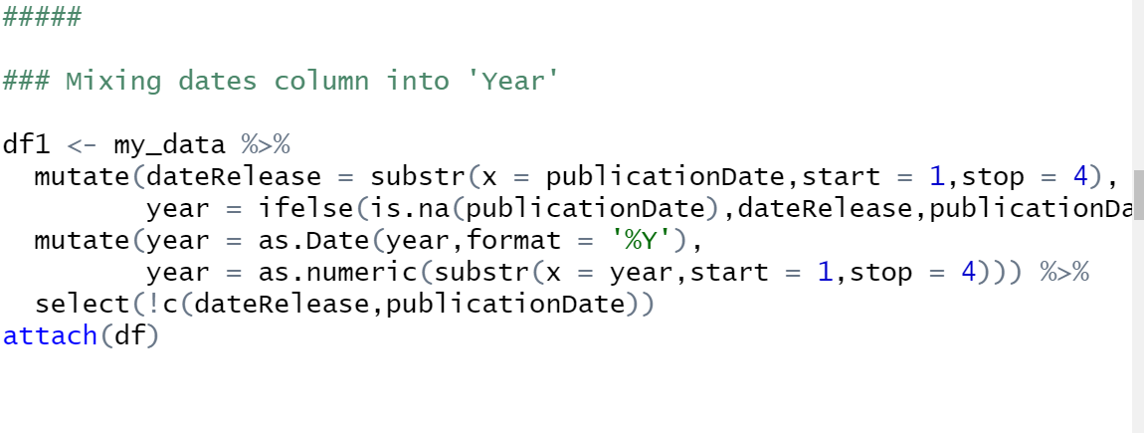
Missing dates

Slide 9
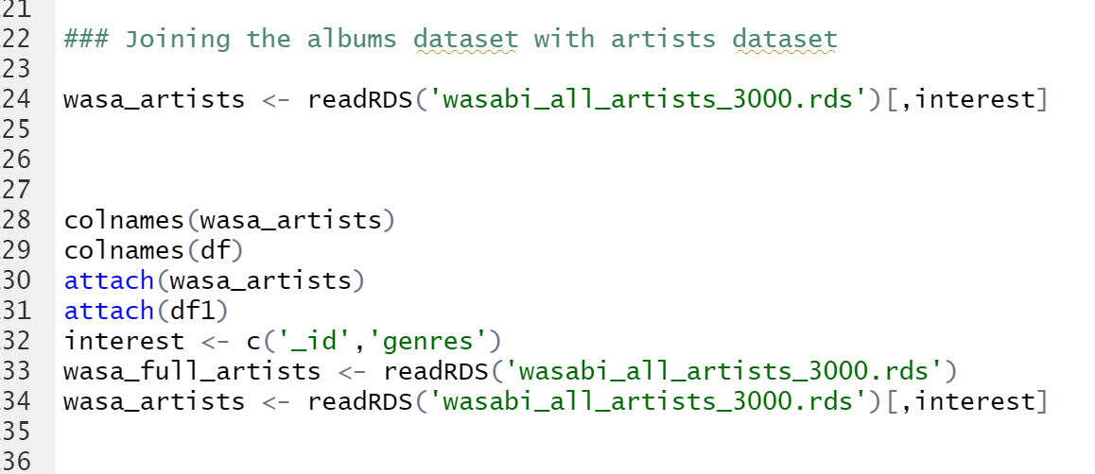
Joining Dataset

Slide 10
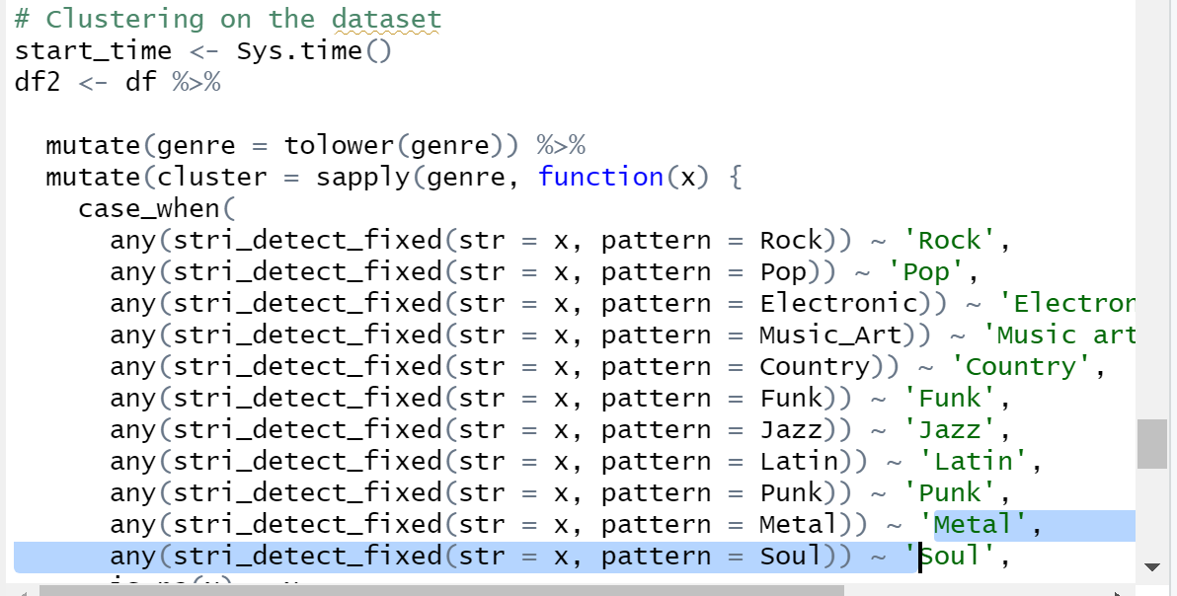
Clustering

Slide 11
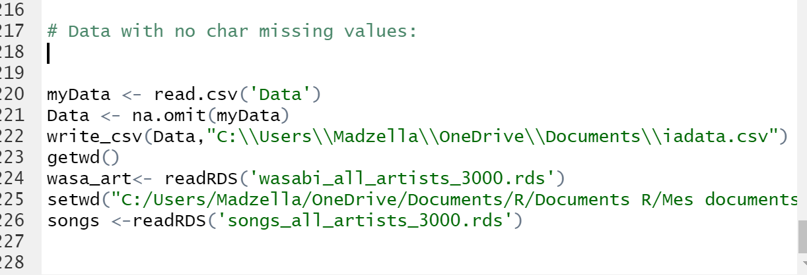
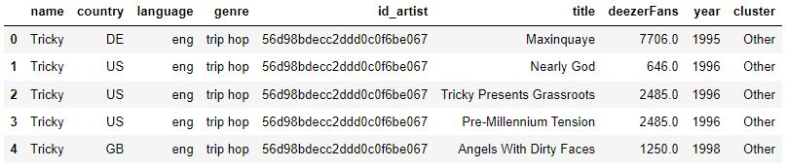

Slide 12
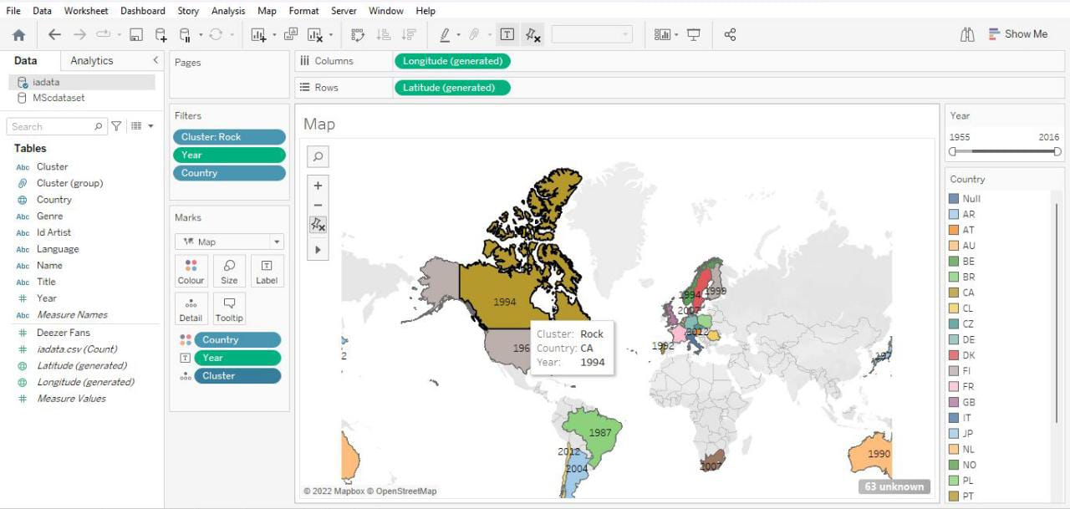
Data Visualization

Slide 13
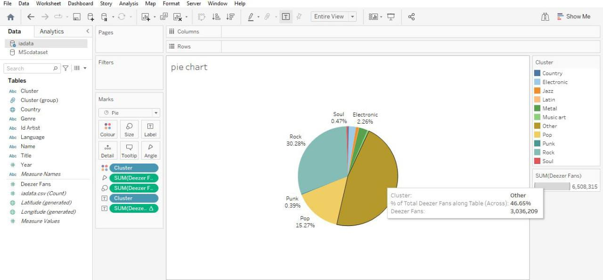

Slide 14
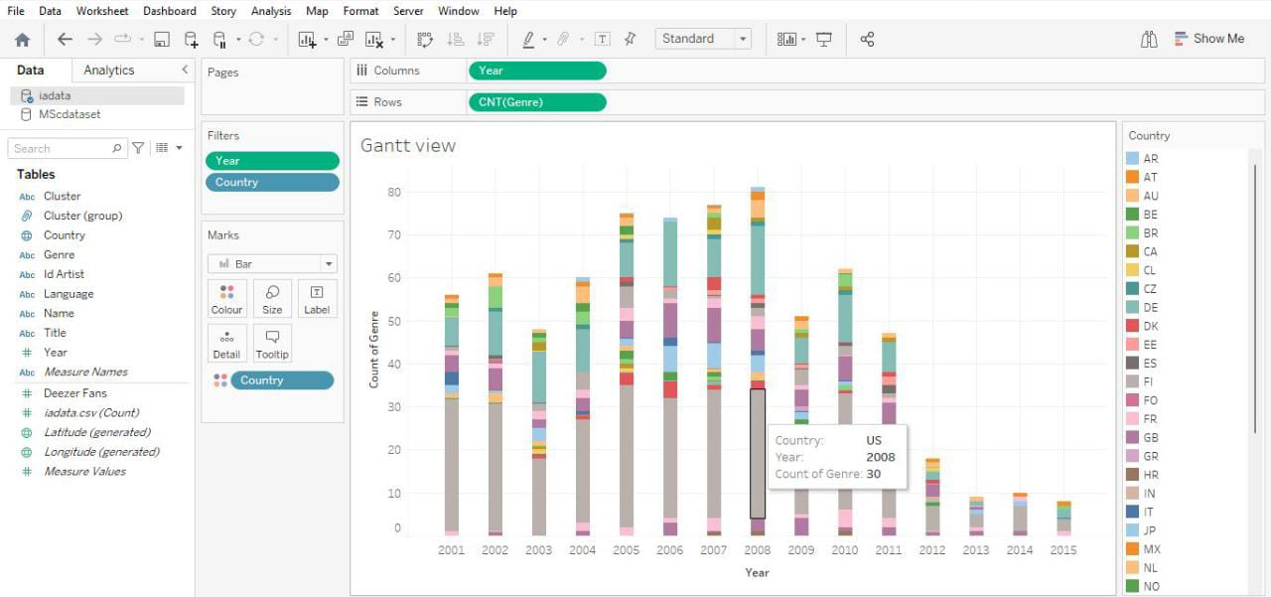

Slide 15
Conclusion
• Considering Imbalance unknown data, visualization showing huge unknown part. On removal of unknown data, the remaining data is very minimal.
• Based on the data and the objective, data visualization should be chosen. Every data visualization technique has its own qualities and capabilities which may not be satisfied by other techniques.
• Data should be processed properly, otherwise while implementation the visualization, manipulating the data will be a complex task.

